Slide 1



CREDIT ANALYSIS
BY:
SUMANAYANA KONDA (002786769)
SREEJA VANGOORI (002788038)

Slide 2
TABLE OF CONTENTS
01
02
03
04
05
06
Introduction
Methodology
Correlation
Algorithms
Results
Conclusion

Slide 3


INTRODUCTION
Credit analysis refers to the process of determining whether an individual petitioning for a loan or entering a debt has the financial health and resources to service the debt in the future thorough their history with credit.
Motivation: Prevent rejections for deserving loan applicants and reduce bank employees work burden.
Goal: Produce a Machine learning model capable of predicting whether a loan application would be approved or rejected.

Slide 4
METHODOLOGY
DATA PREPARATION
DATA ANALYSIS
Eradicating columns with more than 60 percent null values.
Arranging the dataset in a formattable pandas dataframe.
Univariate Categorical feature analysis
Univariate continuous features analysis
Bivariate analysis Categorical-categorical
Bivariate analysis Categorical-Continuous

Slide 5
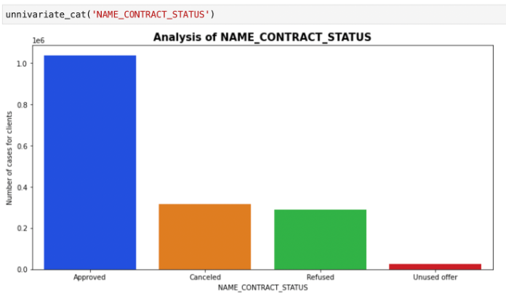
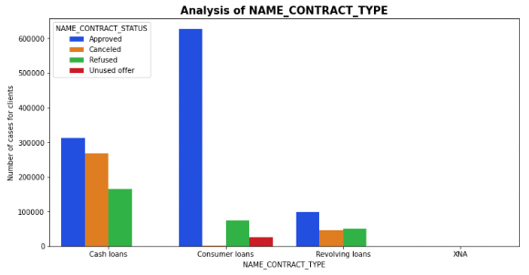
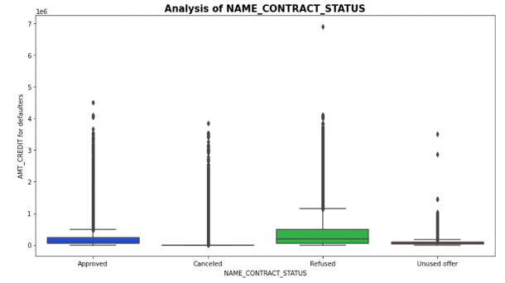
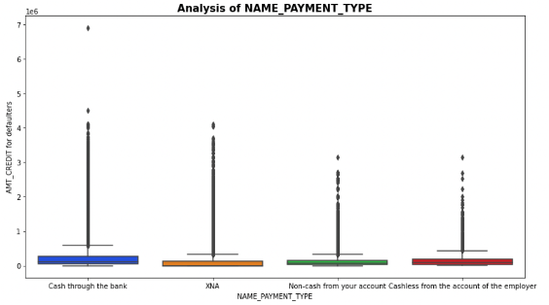
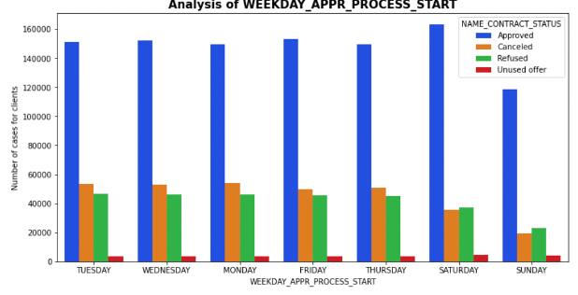
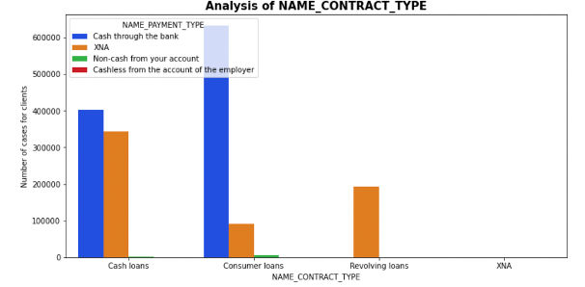
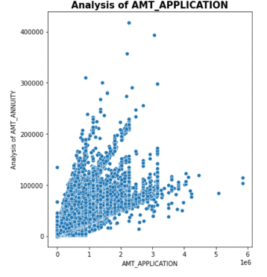
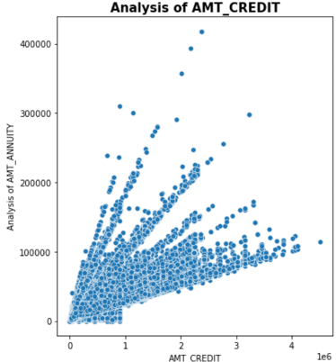
DATA ANALYSIS

Slide 6
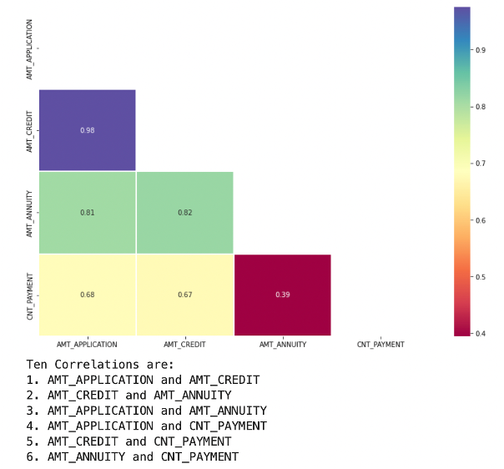

CORRELATION
Correlation is used to determine the relationship between variables or features in a dataset and can help in determining the columns that needs to selected for building a model of prediction.

Slide 7
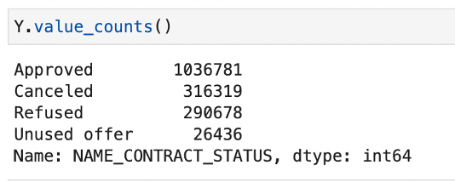
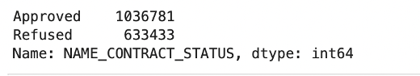
Data Manipulation
The Y (target) is imbalanced.
The Cancelled, Refused, Unused Offer sections are combined.
The dataset is oversampled
The target column is now balanced.

Slide 8
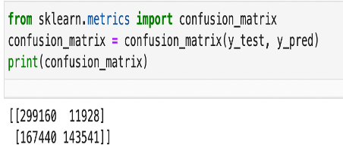
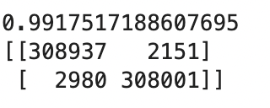
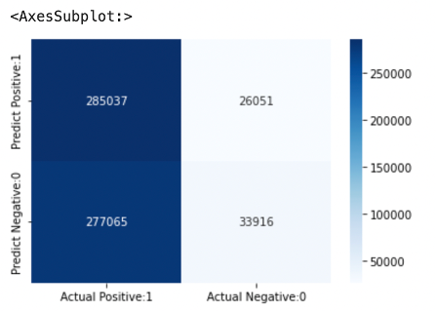
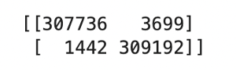
Algorithms
Linear Regression
Decision Tree Classifier
Naive Bayes Classification
XGBClassifier

Slide 9
RESULTS
Logistic Regression
0.71
Naive Bayes Classification & XGBoost Classfier
0.50
Decision Tree Classifier
0.99

Slide 10



CONCLUSION:
The score of 91.63 percent is a decent accuracy value with enough space to make accurate predictions and not become unrealistic.
The model constructed checks all the conditions set in the goals satisfactorily and has the ability to developed further with greater scope and much larger dataset for more accurate model building.

Slide 11
RESOURCES
[1]https://www.datasciencelearner.com/svm-classifier-sklearn-implementation-python/
[2]https://towardsdatascience.com/beginners-guide-to-xgboost-for-classification-problems-50f75aac5390
[3] https://machinelearningmastery.com/naive-bayes-classifier-scratch-python/
[4]https://towardsdatascience.com/decision-tree-classifier-explained-in-real-life-picking-a-vacation-destination-6226b2b60575
[5] https://www.datatechnotes.com/2019/07/classification-example-with.html
[6]https://www.analyticsvidhya.com/blog/2022/02/loan-approval-prediction-machine-learning/
[7]https://www.investopedia.com/terms/c/creditanalysis.asp#:~:text=Credit%20analysis%20evaluates%20the%20riskiness,investing%20in%20that%20particular%20entity

